Slide 1
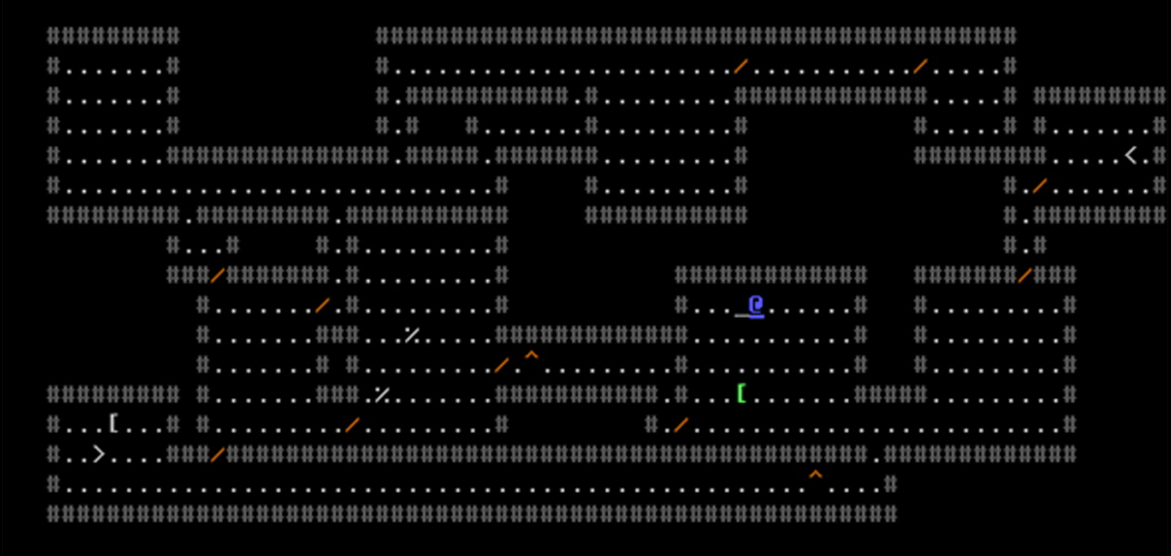
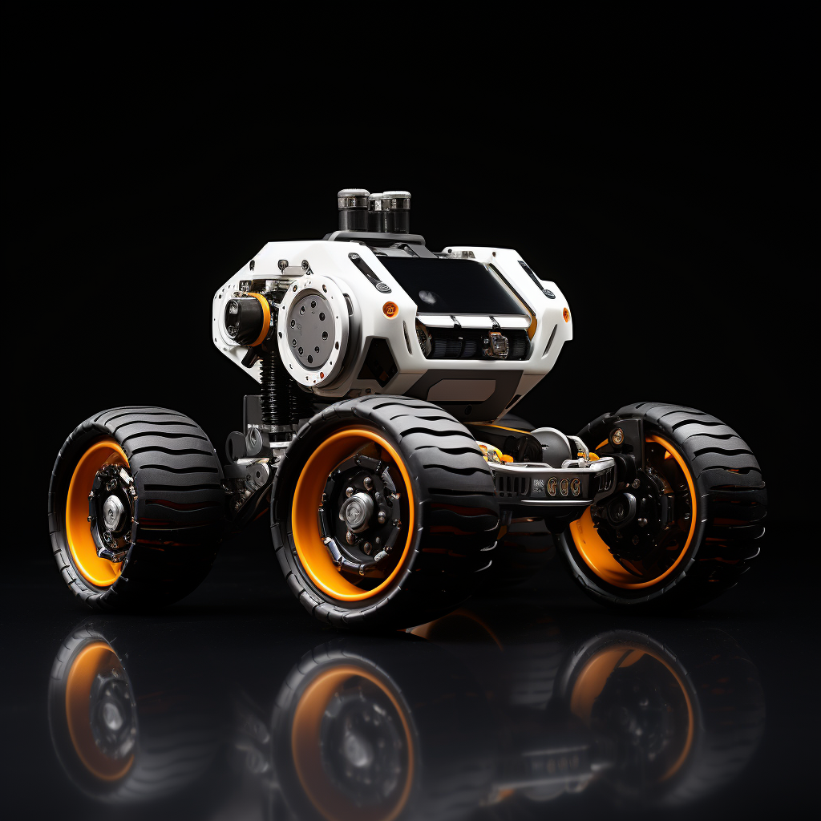
Advolition
Generating Random Arenas

Slide 2
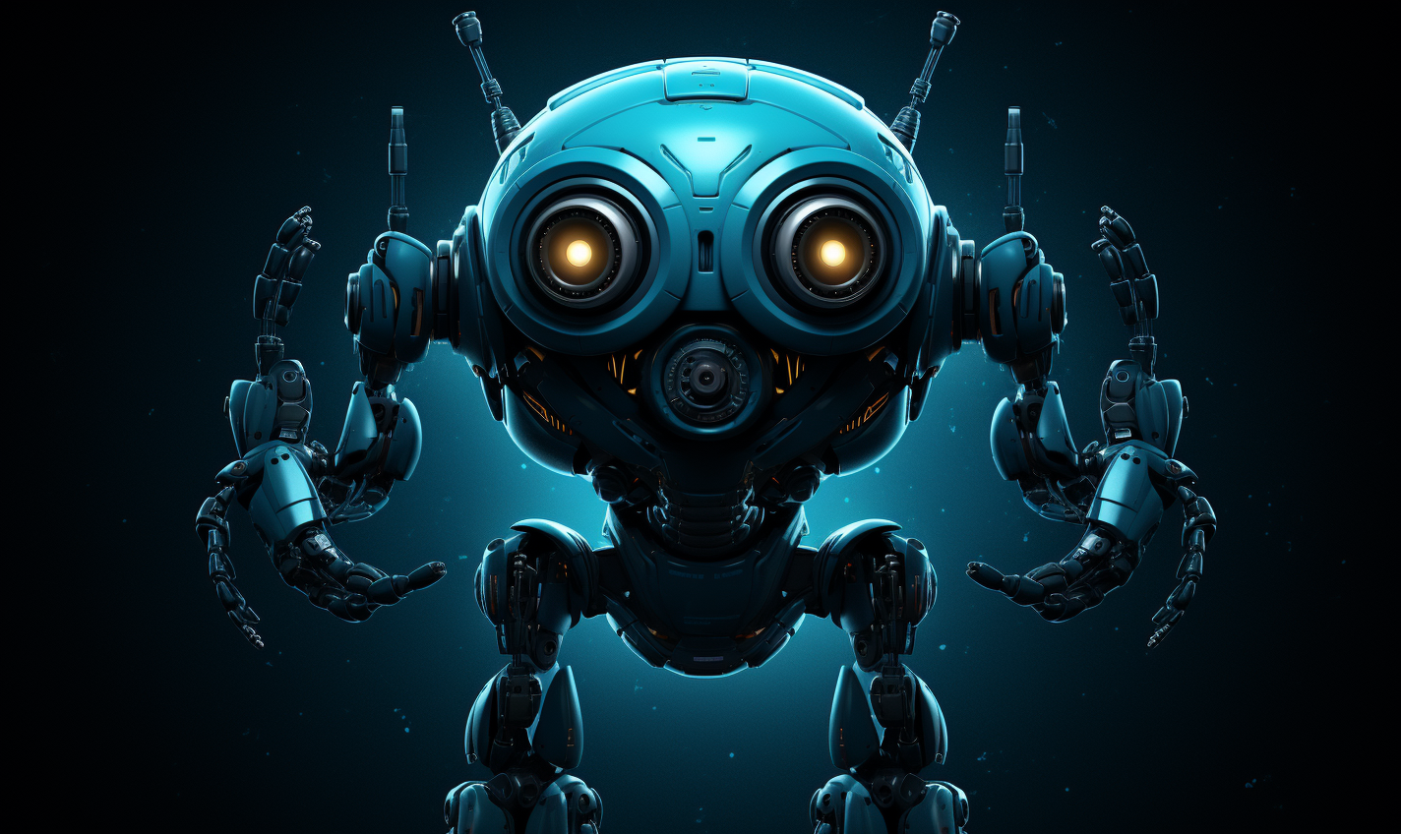
Tournament Robotics
Notes:
My name is Dave and I'm working on a series of robotic challenges to teach students how to code.

Slide 3
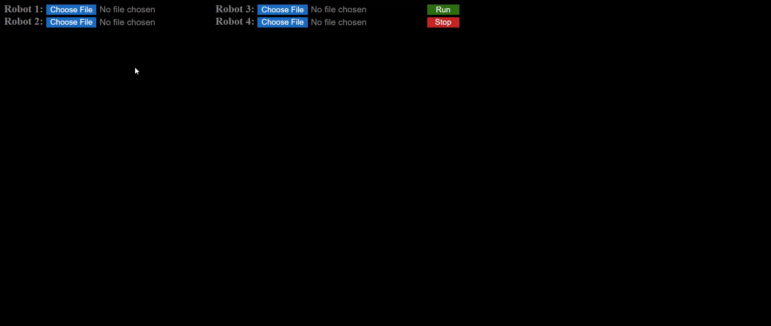
Advolition
Notes:
Advolition is one of these challenges.
In Advolition, players use JavaScript to code robots that battle each other in a roguelike dungeon.

Slide 4
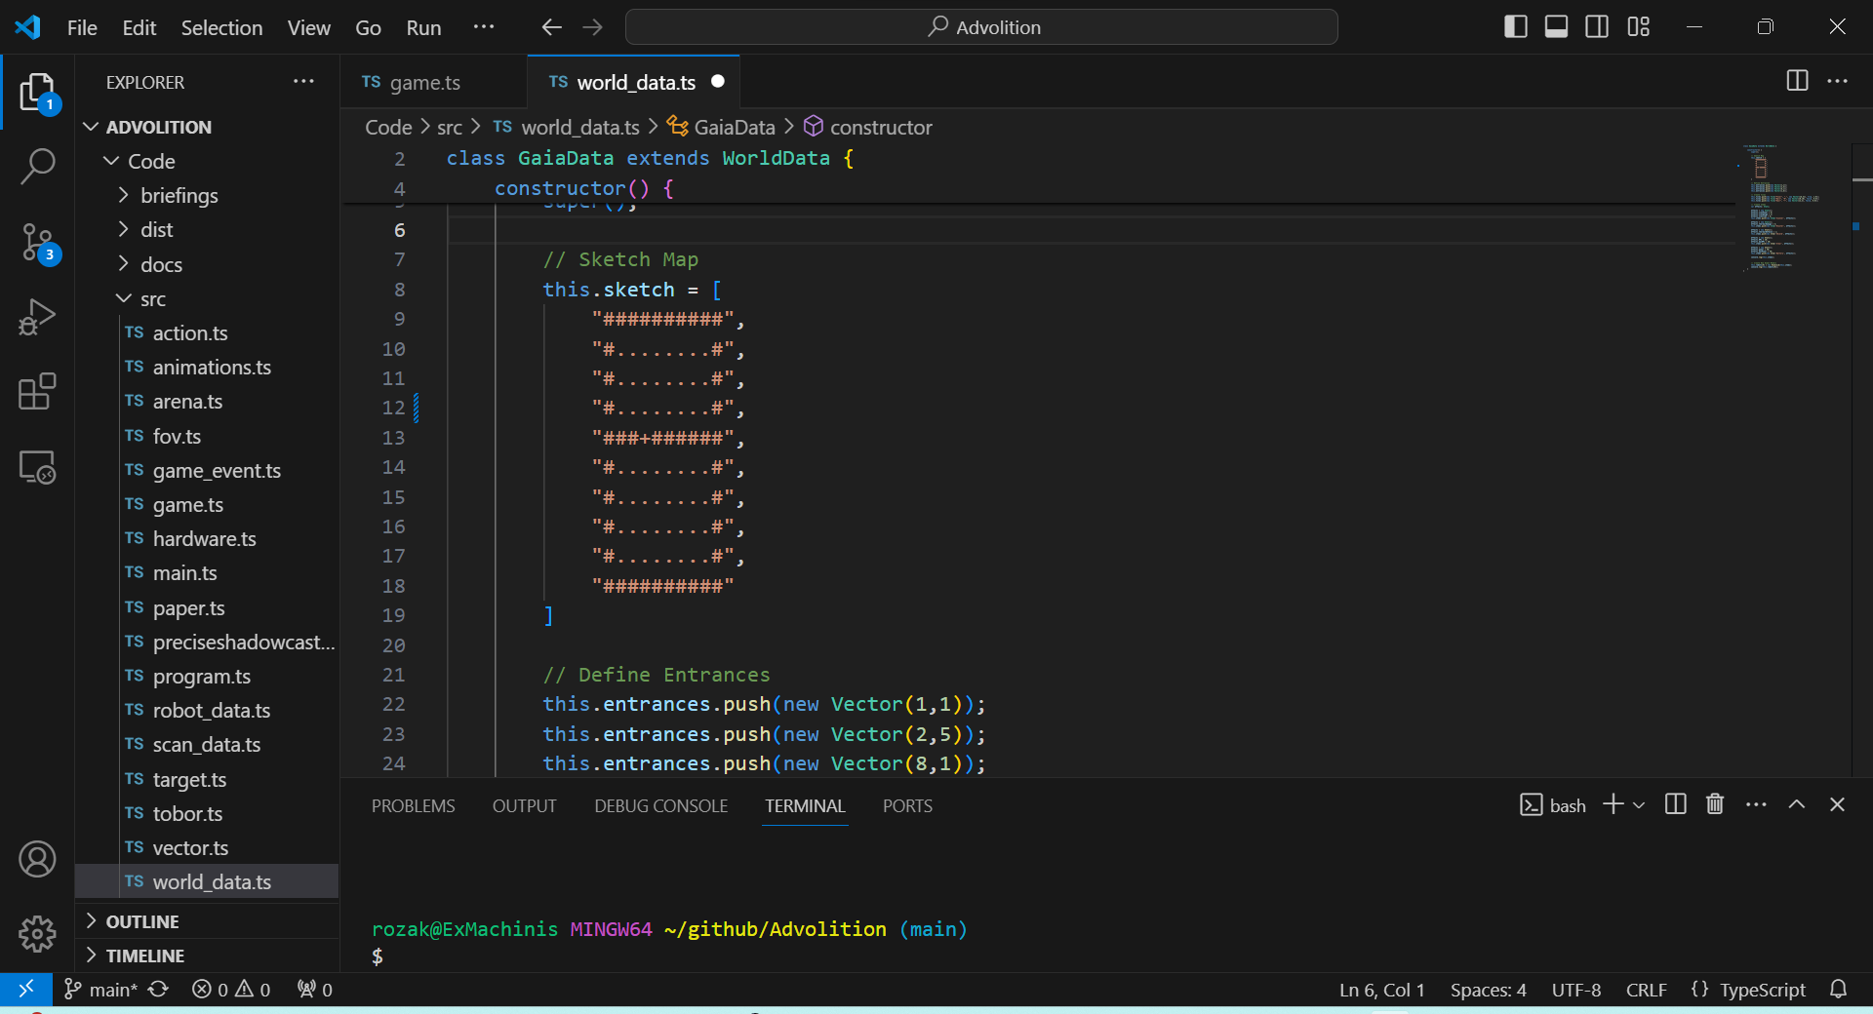
Notes:
The current version of the game relies on a simple hand-drawn ASCII sketch to render the arenas. I did this mainly for testing components.

Slide 5
Notes:
Now I'm ready to implement a random dungeon generator that is capable of creating more complex dungeons like those used in traditional roguelike games.

Slide 6
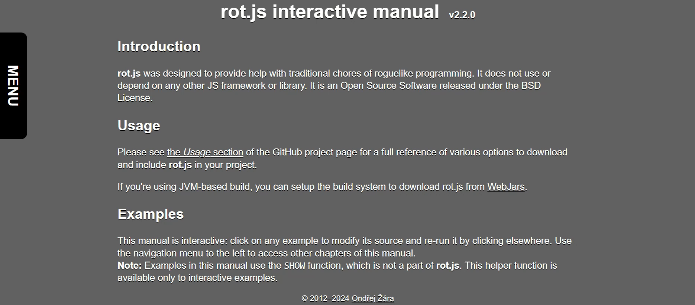
Notes:
Fortunately, ??? has already created a full set of opensource roguelike developer tools at ROT.js. Among these tools is a dungeon generator routine that lays out rooms and corridors in a defined space.

Slide 7
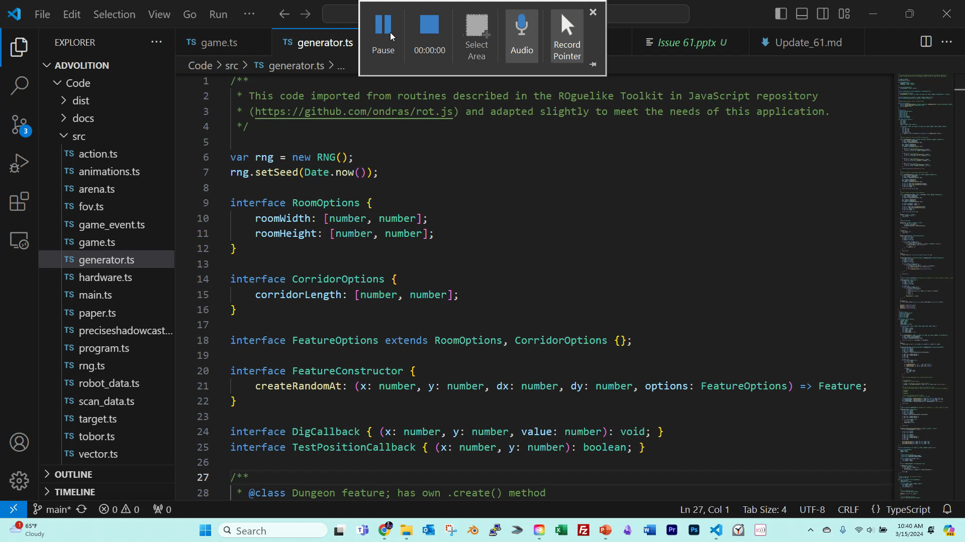
Notes:
All the ROT.js routines are well documented, and it didn't take long to integrate them into the Advolition script.

Slide 8
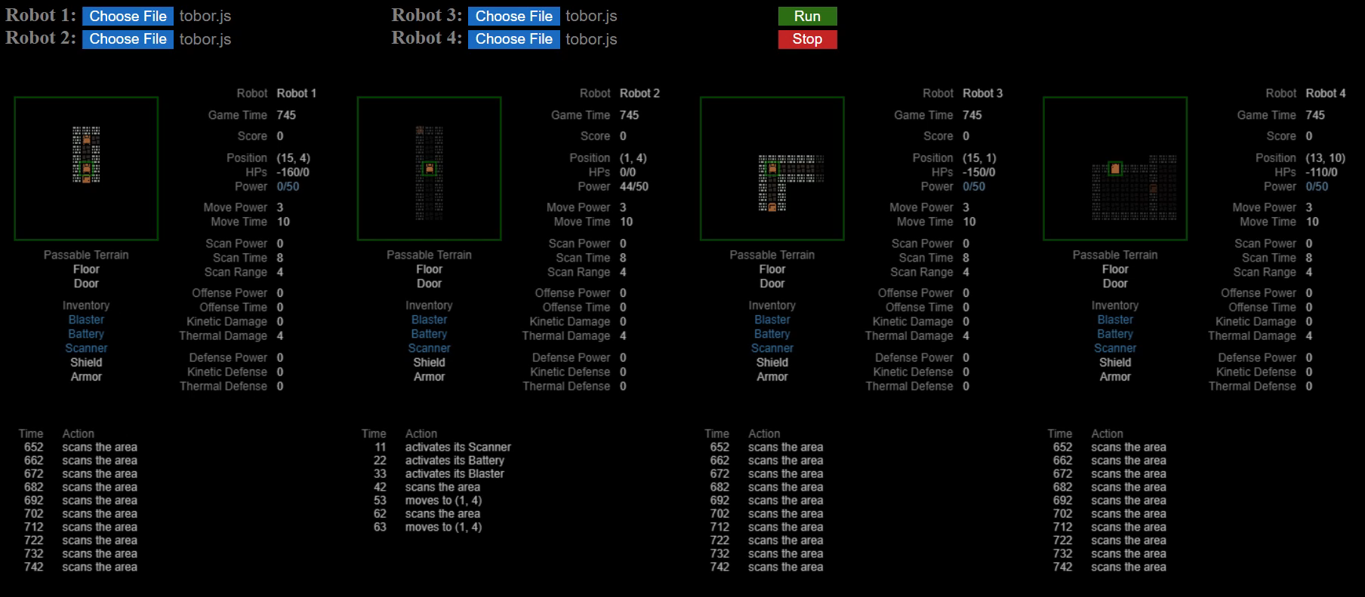
Notes:
After tweaking the code to meet my needs, I have a system that will place up to four player robots in a randomly generated arena of any size!

Slide 9

Up Next…
Notes:
My next step will be to code an algorithm for randomly distributing items throughout the dungeon. The player and non-player robots will be able to use these items to increase specific traits that will help them prevail in combat.

